Slide 1

DEV 109 – Intro to web development
Presented by Devin Graupmann
Time:

Slide 2
My experience
What was your previous knowledge of HTML/CSS/Javascript?
Prior to this Class I had some intermediate knowledge of HTML and CSS. I also had some minor knowledge of Javascript.
How did this class change your view on Web Development?
Before this class, I hadn't particularly focused on Accessibility when coding. I'm now more aware of how to make my products accessible.
What was the best part of doing this project?
I had lot of fun experimenting with new features the project. I particularly enjoyed utilising IFRames to make a synced navigation throughout the website.
What was the most challenging part of doing this project?
While working on the project we occasionally had issues with GitHub which were sometimes difficult to fix.
How would you rate this project overall from 1-10 where 1 is the lowest and 10 the highest, and why?
I'd rate the project a 7. While it was a fun project, it was tedious getting instructions for it through a weekly release format rather than having all the requirements laid out before hand.
What would you recommend to future students taking this class?
I'd recommend getting a solid layout for the website and file structures setup early and then adding onto it as the quarter continued.

Slide 3
Favorite Parts of The Site

Slide 4
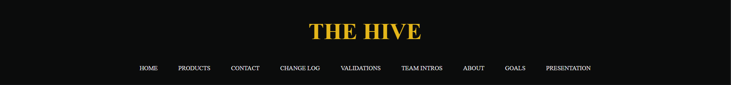
Synced Nav

Slide 5
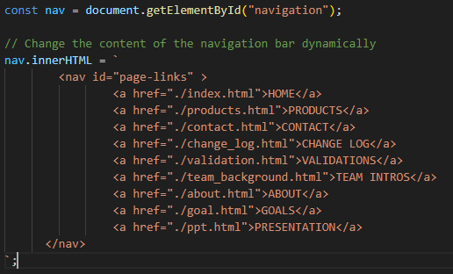
Nav Code

Slide 6
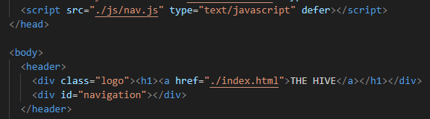
Nav implementation

Slide 7
Benefits of Having a Synced Nav

Slide 8
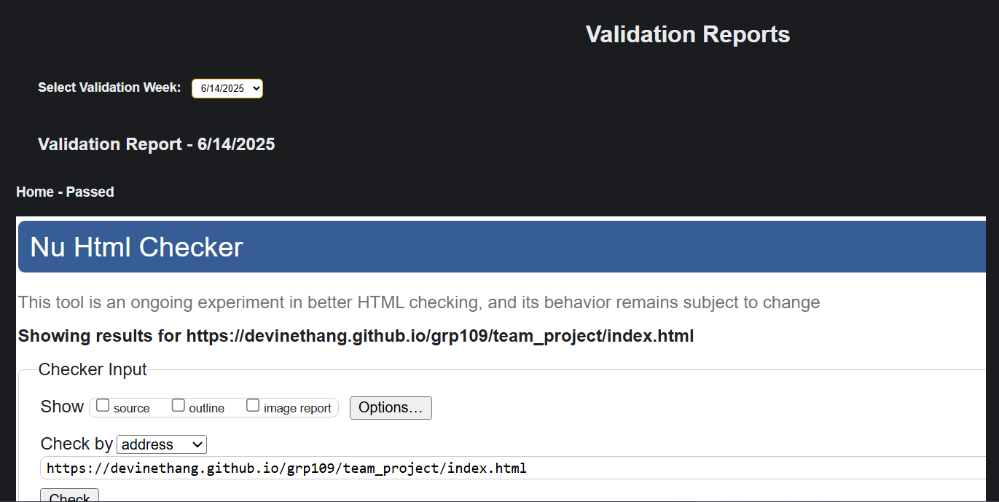
Validation Week Selection

Slide 9
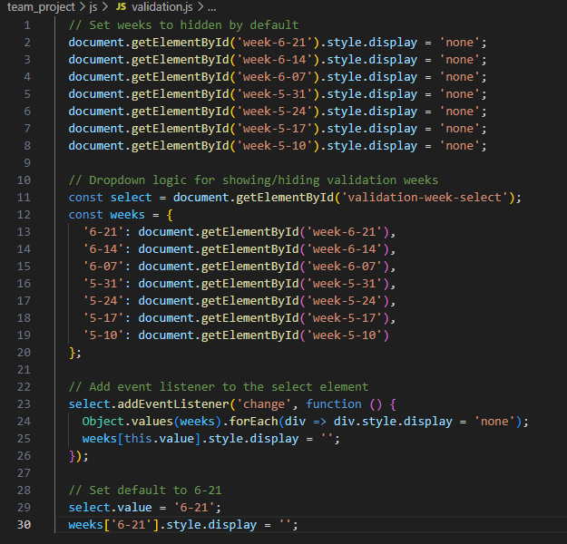
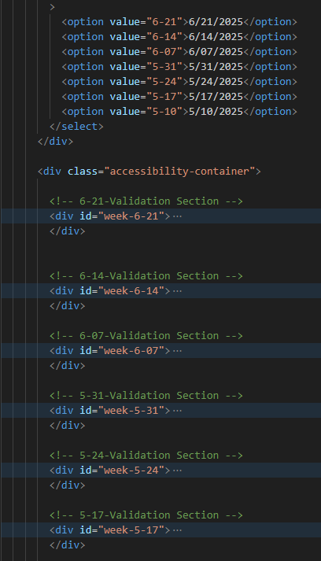
Week Selection Code

Slide 10
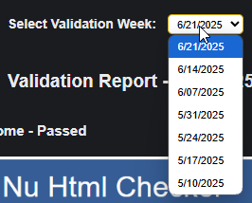
Implementation

Slide 11
Benefits of Week Selection Compared to no week selection

Slide 12
Take aways From the Class
Positive | Negative
Fun Group Project | Disappointing Participation Requirement
Becoming more familiar with web dev | Stressful Group Grading each week
Github Pages | Disappointing Initial Assignments

Slide 13
Experience working with the team

Slide 14
Upsides of working with the team and working as a group

Slide 15
Downsides of working with the team and as a group

Slide 16
Thank you for listening

